Slide 1


Introduction to Programming
Group Assignment

Slide 2
01
Distinguish between programs, programming and programmers
· Construct algorithms using real world scenarios
Catalog
02
Create flowcharts (sequential) to solve basic problems
CONTENTS
03
Distinguish between variables and constants
Demonstrate an understanding of the rules to be followed when naming identifiers.
Recommend appropriate data types that should be used to store given data.
04
Use the DEFINE statement accurately
· Distinguish between operators and operands.
· Distinguish between statements and expressions.
· Evaluate expressions accurately.
· Write expressions accurately given arithmetic form of expression
· Write simple sequential statements using pseudocode

Slide 3
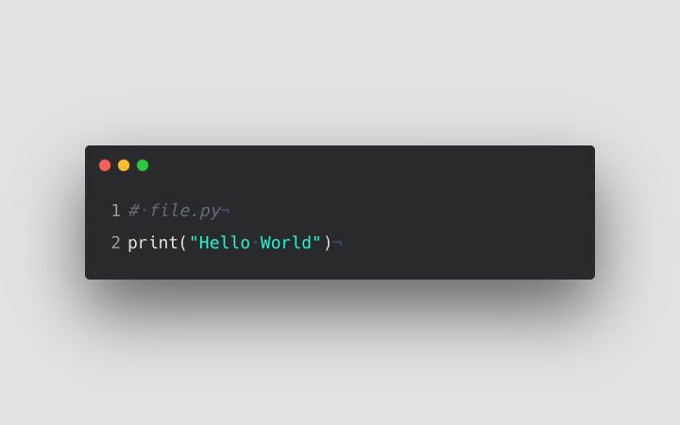
Distinguish between programs, programming and programmers
1 Distinguish between programs, programming, and programmers.
A program is a series of instructions to a computer to make it perform a function or functions.
Programming is the process of writing code to facilitate specific actions in a computer, application/software program.
A programmer is a person who creates a program.
Programmer,
programs, programming
01
Definition

Slide 4
Construct algorithms using real-world scenarios.
Algorithms - A set of finite rules or instructions to be followed in calculations or other problem-solving operations.
The goal is to determine whether the gas tank is empty or full.
Input:
If (the tank falls between full and half)
Then
state “tank is full”
End if
If (the tank falls in between half and empty)
Then
State “tank is empty”
End if
3. Health care.
Goal: Reorder Supplies.
Input:
If (the number falls between 15 and 20)
Then
Send alert “low supply”
End if
If (the number falls in between 0 and 10)
Then
Send alert “Reorder”
End if

Slide 5
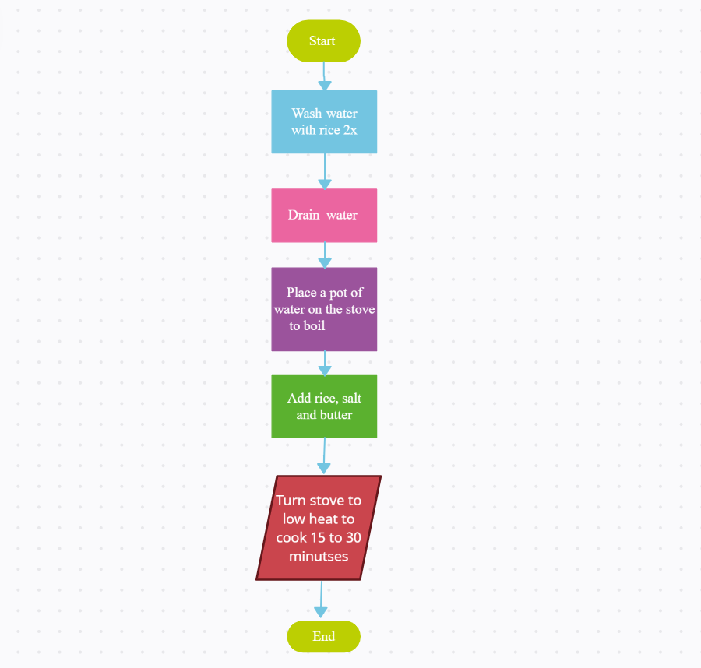
2. Create flowcharts (sequential) to solve basic problems

Slide 6
3. Distinguish between variables and constants
Constants
Characteristics :
Characteristics :
Values can be changed at any time during the course of the program. X + 4 = 7.
X is the variable value, and it can be changed
Variables
Throughout the program, values cannot be changed. E.g., x + y = 8.
8 is a constant value that cannot be changed.

Slide 7
Usage:
Constants
Use constants when you want to declare something that won’t be changed midway through your program's execution.
variables
Use variables to store data that may or may not change during the running of the program.

Slide 8
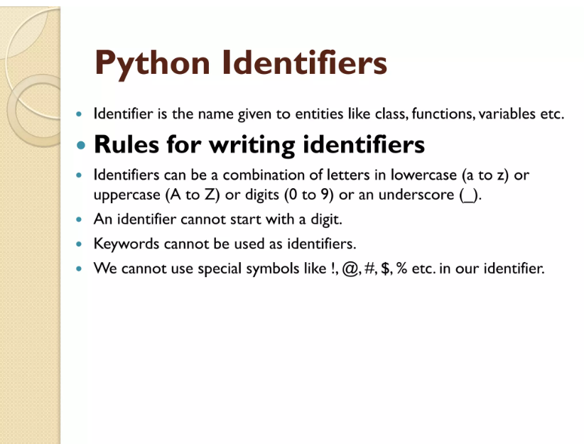
Demonstrate an understanding of the rules to be followed when naming identifiers.
What is an identifier? Python Identifier is the name we give to identify a variable, function, class, module or other object.
Identifiers are case-sensitive, meaning that "myVar" is not the same as "myvar".
It is important to follow these rules when naming identifiers in Python to avoid syntax errors and to ensure that the code is clear and easy to read. It is also a good idea to use descriptive and meaningful names for identifiers to make the code more self-explanatory.

Slide 9
Recommend appropriate data types that should be used to store given data.
A list of student names: The appropriate data type to store this data would be a list, as it allows for the storage of multiple values in a single variable.
A customer's phone number: The appropriate data type to store this data would be a string, as phone numbers can contain letters and symbols in addition to numbers.
A list of purchase prices: The appropriate data type to store this data would be a list of floats, as purchase prices may contain decimal points.
A user's password: The appropriate data type to store this data would be a string, as passwords can contain letters, numbers, and special characters. It is also important to store passwords in a secure way, such as by hashing them before storing them.
A list of Boolean values (True or False): The appropriate data type to store this data would be a list of Booleans.

Slide 10
4. Use the DEFINE statement accurately.
The DEFINE statement in Python is used to define a constant value or expression that cannot be changed throughout the program. It is commonly used to assign values to variables that will not be modified or changed in any way.
For example:
DEFINE pi = 3.14159 # defines the value of pi as a constant
DEFINE max_speed = 60 # defines the maximum speed as a constant
Once these constants have been defined, they cannot be modified or changed in any way throughout the program. Attempting to do so will result in an error.

Slide 11
· Distinguish between operators and operands.
The operators indicate what action or operation to perform, and the operands indicate what items to apply the action to. Eg. 5 + 10
The + is the operator.
The 5 and 10 are the operands.

Slide 12
Distinguish between statements and expressions.
Arithmetic form: 3 + 4
Expression: "Three plus four equals seven."
Arithmetic form: 5 - 2
Expression: "Five minus two equals three."
Arithmetic form: 8 * 5
Expression: "Eight times five equals forty."
Arithmetic form: 12 / 4
Expression: "Twelve divided by four equals three."
Arithmetic form: (7 + 3) * 4
Expression: "Seven plus three, multiplied by four, equals twenty-eight."

Slide 13
· Write simple sequential statements using pseudocode
INPUT unit_price, quantity
SET cost = unit_price * quantity
SET total_cost = cost * 1.05
OUTPUT total_cost
To check if a number is positive, input the number and check if it is greater than zero:
INPUT number
IF number > 0
OUTPUT "positive"
ELSE
OUTPUT "non-positive"
To calculate the area of a rectangle, input the width and height, then multiply the two values and output the result:
INPUT width, height
SET area = width * height
OUTPUT area
To calculate the total cost of an order, input the unit price and quantity, then multiply the two values and add the sales tax (assumed to be 5%):

Slide 14
Introduction to Programming
THANK YOU

